Slide 1
Phishing Awareness Training
Islam Gadirli
CodeAlpha

Slide 2
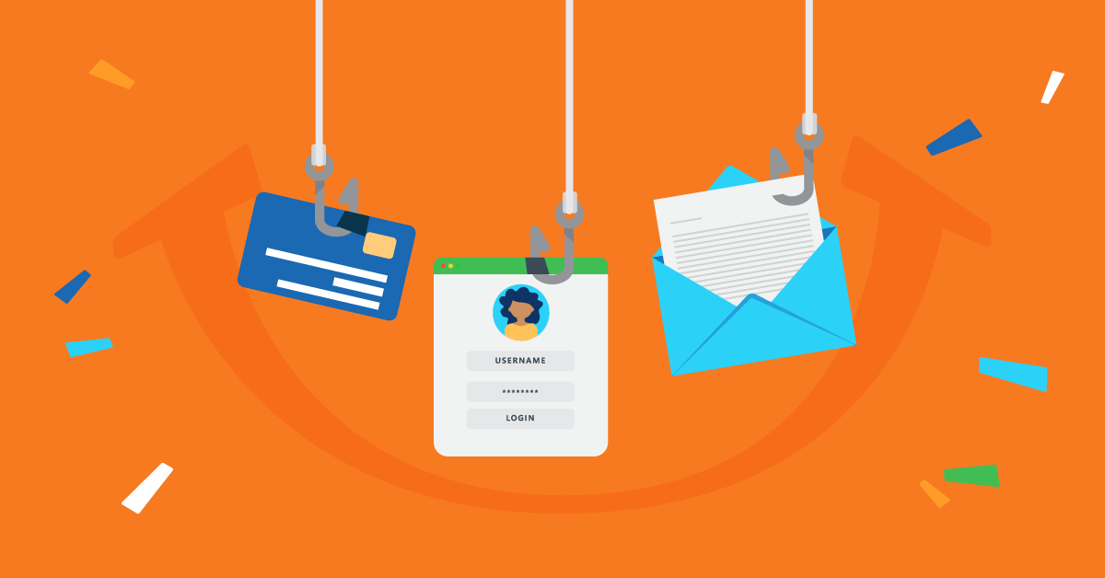
AGENDA
Introduction to Phishing
Common Types of Phishing Attacks
Recognising Phishing Emails and Fake Websites
Social Engineering Tactics
Prevention and Best Practices
Real-World Phishing Case Studies
Interactive Quiz
Conclusion & Key Takeaways

Slide 3
1
Introduction

Slide 4
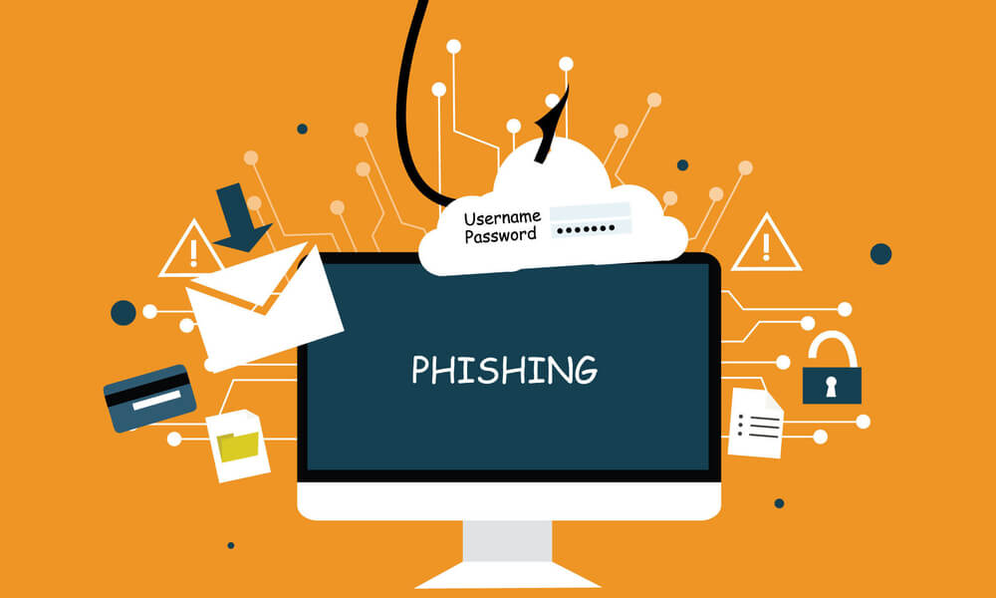
What is Phishing?
Definition: Phishing is a cyber attack where criminals impersonate trusted organisations to trick people into revealing sensitive data (like passwords, credit card numbers, or login credentials).
Purpose: Gain access to accounts, steal money, or infect devices with malware.
Real Example: In 2020, Twitter employees were phished via phone calls pretending to be IT staff, leading to the hacking of high-profile accounts (Elon Musk, Barack Obama).

Slide 5
2
Types of Phishing Attacks

Slide 6
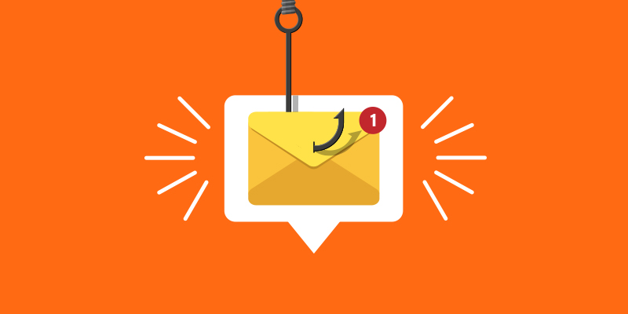


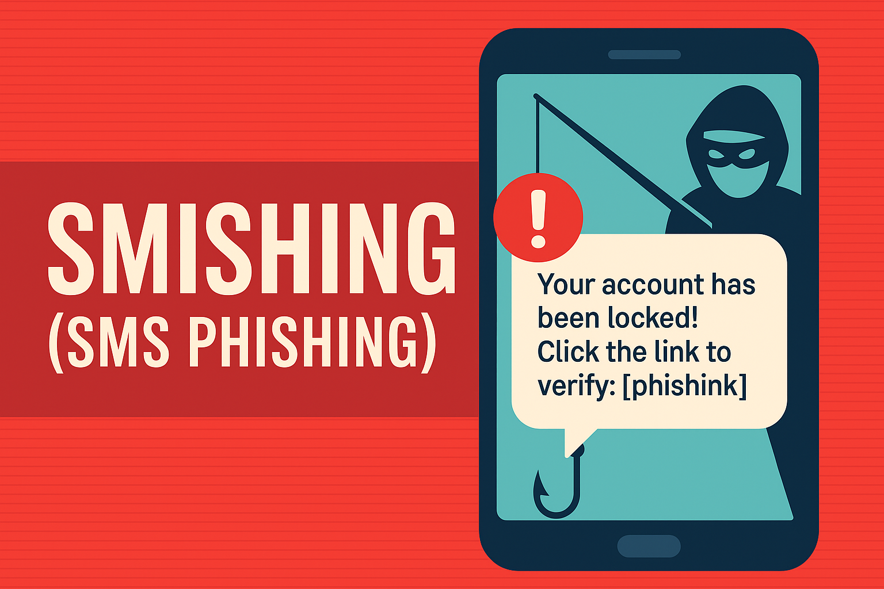
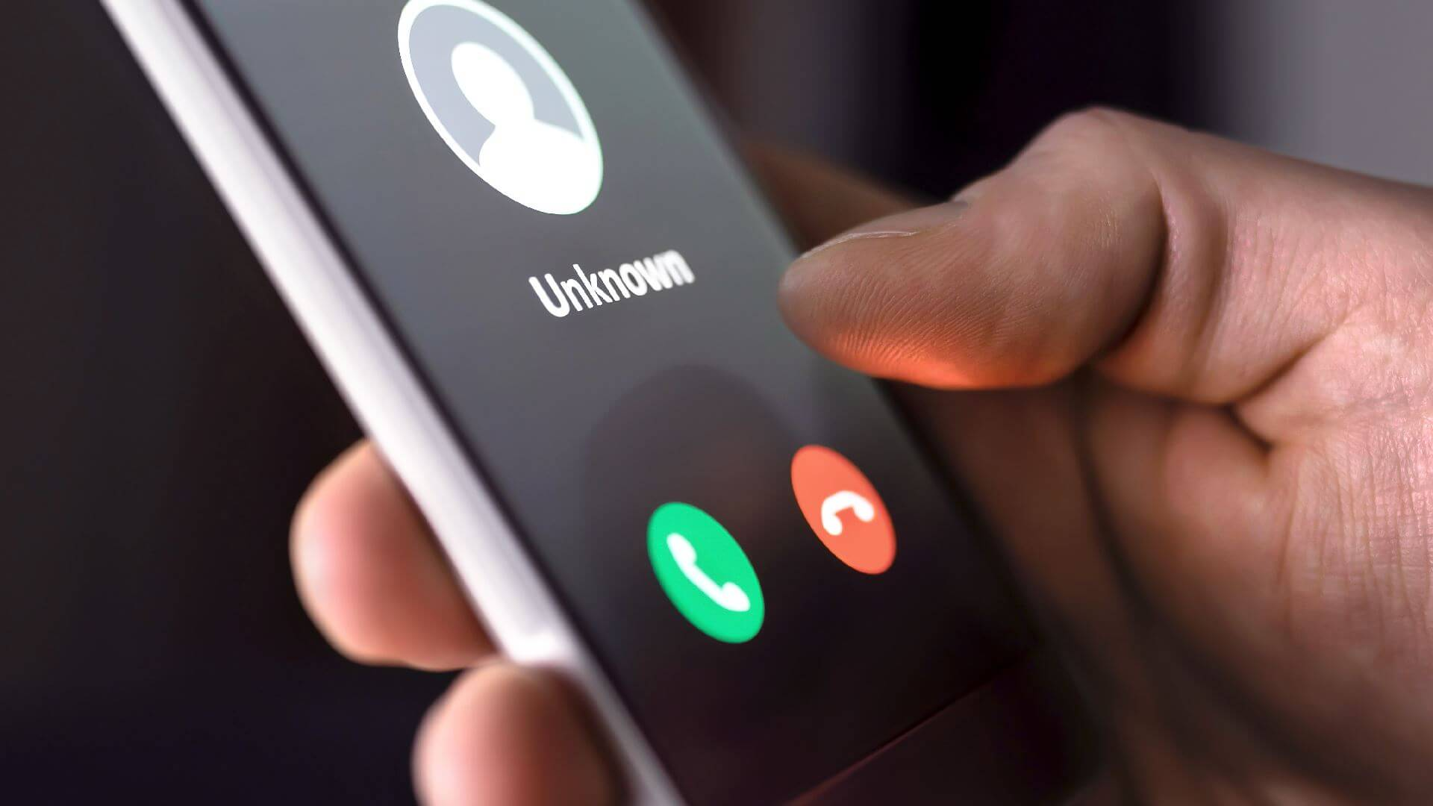
Email Phishing
Whaling
Mass emails claiming to be from banks or services.
Example: “Your PayPal account is locked. Click here to verify your identity”.
Spear Phishing
Targets executives or high-profile individuals.
Example: Fake invoice sent to CFO from a lookalike vendor address.
Targeted at specific individuals or organisations.
Example: A HR employee receives an email from “CEO@company.co” asking for tax data.
Smishing
Vishing
Mass emails claiming to be from banks or services.
Example: “Your PayPal account is locked. Click here to verify your identity”.
Voice call pretending to be a bank/tech support.
Example: “We noticed unusual transactions. Please confirm your card number”.

Slide 7
3
How to Recognize Phishing Emails

Slide 8
Warning signs
Unfamiliar or slightly altered sender address Example: support@amaz0n.com, info@micros0ft-support.com, billing@netfl1x.co
Urgent or threatening tone Example: Your account will be permanently suspended within 24 hours!
Requests for personal data or login info Example: Please confirm your password or card number to continue
Spelling or formatting errors Example: Dear Costumer, we have noticed unussual activitty on your account
Suspicious links or attachments Example: Files like .exe, .zip, .scr, or links that don’t match the official domain

Slide 9
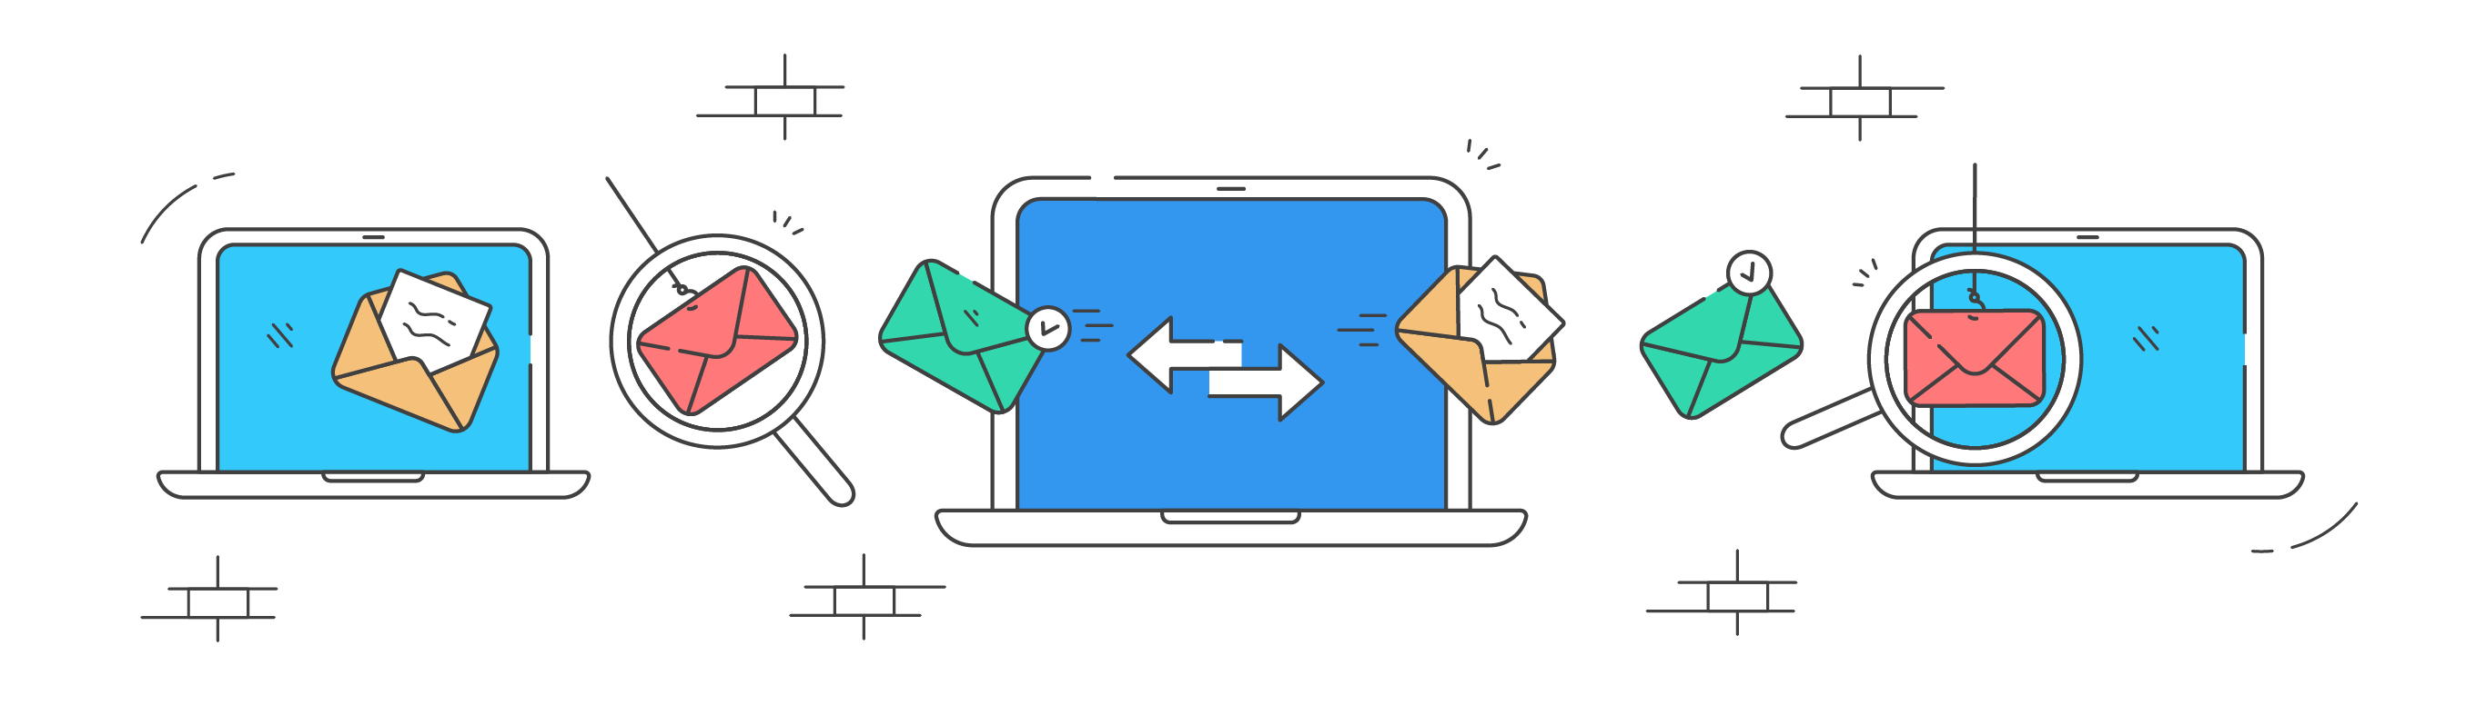
Subject: “Unusual Activity Detected on Your Account”
From: security@bankofamerca.com
Message: “Dear Customer, we’ve noticed unauthorised access to your account. Please verify your identity by logging in here: [bankofamerca-secure.com/login]”.
Subject: “System Alert: Virus Detected on Your Computer!”
From: support@windowsfix.com
Message: “Your system is infected. Call our Microsoft-certified technician immediately: +1-800-XXX-XXXX”.
Banking Scam
Tech Support Scam
⚠️ Trick: Fake link leads to a cloned banking site to steal login details.
⚠️ Trick: Fake call centres ask for payment or remote access to install malware.
Subject: “Your Package Delivery Failed!”
From: delivery@dhl-service.info
Message: “We couldn’t deliver your package due to incomplete address information. Please confirm your address here to reschedule delivery”.
Subject: “Someone Tried to Log In to Your Instagram Account”
From: security@insta-support.com
Message: “We detected a login from an unknown device. Click below to secure your account”.
Delivery Scam
Social Media Scam
⚠️ Trick: Fake tracking link installs malware or requests card details for “redelivery fee”.
⚠️ Trick: Fake link mimics the Instagram login page to steal username and password.
Subject: “Exciting Work-From-Home Opportunity”
From: hr@global-careers.net
Message: “We reviewed your CV online. Congratulations! You’re selected for a remote position. Please fill out the attached form to complete hiring”.
Subject: “Your Norton Antivirus Subscription Has Expired”
From: nortonrenewal@secure-notif.com
Message: “Your device is unprotected! Renew now to continue protection”.
Job Offer Scam
Subscription Renewal Scam
⚠️ Trick: Attachment contains malware or requests sensitive information (like ID number, bank info).
⚠️ Trick: Fake renewal page collects credit card details.

Slide 10
4
Fake Websites and URL Tricks

Slide 11
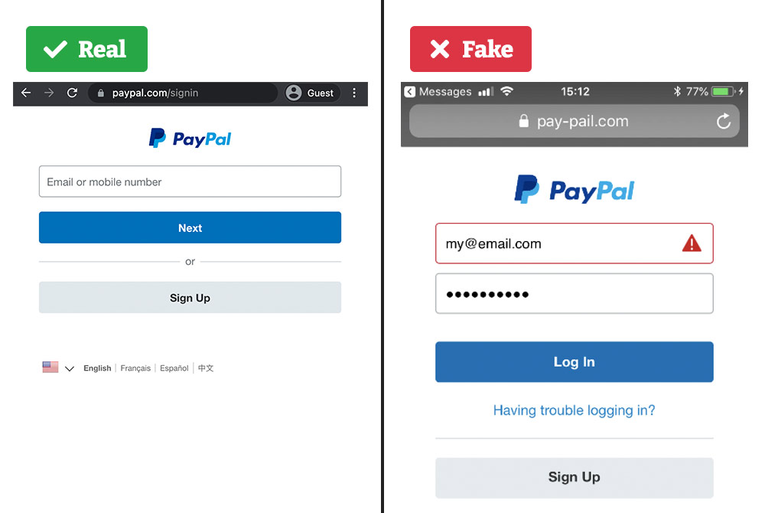
Phishers create lookalike websites with minor URL changes:
www.paypal.com
www.paypaI.com
www.google.com
www.go0gle-support.com
Tips to Identify Fake Sites
✅ Check for HTTPS and a padlock icon.
✅ Double-check domain spelling.
✅ Avoid clicking links in unsolicited emails.
✅ Use bookmarks for trusted sites.

Slide 12
5
Social Engineering Tactics

Slide 13

Tactic | Description | Real-World Example
Pretexting | Creating a fake scenario or story to gain trust and collect information. | An attacker pretends to be an HR officer asking employees to “verify salary details” for payroll update.
Baiting | Offering something tempting (free item, download, or bonus) to trick users into installing malware or revealing data. | A USB drive labelled “Confidential – Employee Bonuses” is left in the office; once plugged in, it infects the PC.
Quid Pro Quo | Promising a benefit or service in exchange for information or access. | Caller claims to be IT support offering to fix slow computers and asks users to disable antivirus.
Impersonation / Authority | Pretending to be a trusted person (manager, IT staff, bank, government). | “This is your CEO - transfer $5,000 immediately for a confidential deal”.
Tailgating / Piggybacking | Gaining physical access by following authorized personnel into secure areas. | A stranger carrying boxes asks an employee to hold the door, so no ID check.
Spear Phishing | Highly targeted emails using personal or company-specific details to appear genuine. | Fake message referencing a recent project asks the recipient to open a malicious “project report”.
Watering Hole | Infecting a website frequently visited by the target group. | Hackers compromise a local supplier’s site to distribute malware to partner companies.
Reverse Social Engineering | Creating a problem so victims contact the attacker for “help”. | Hacker posts fake tech-support ads; victims call and share system credentials.

Slide 14
6
Best Practices to Stay Safe

Slide 15

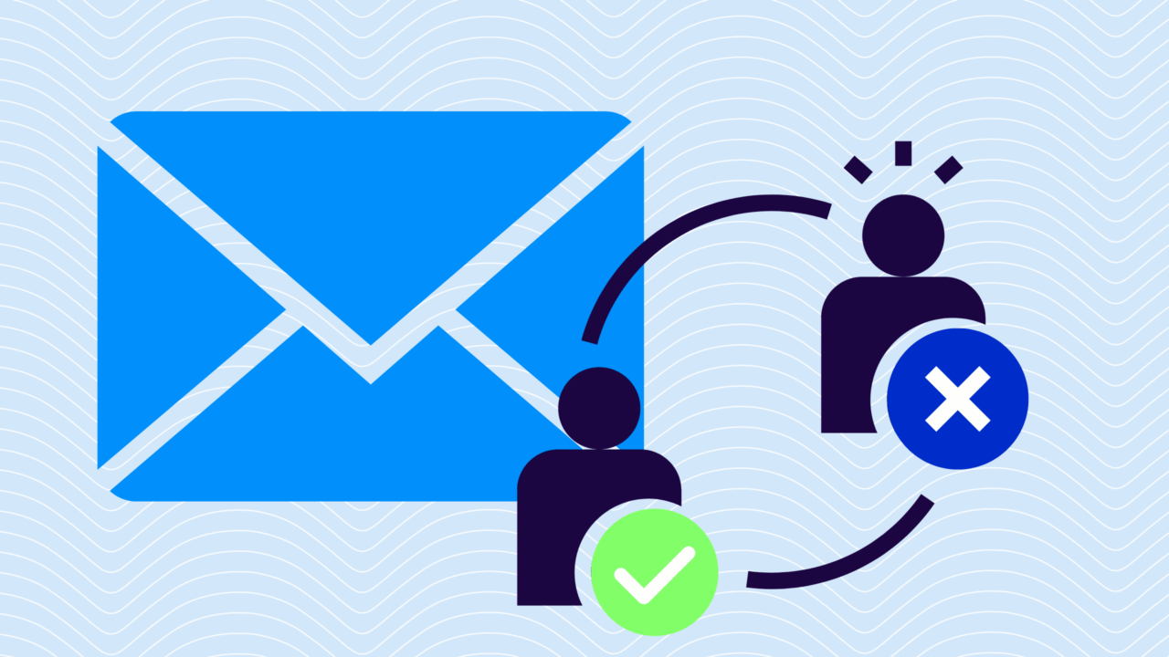
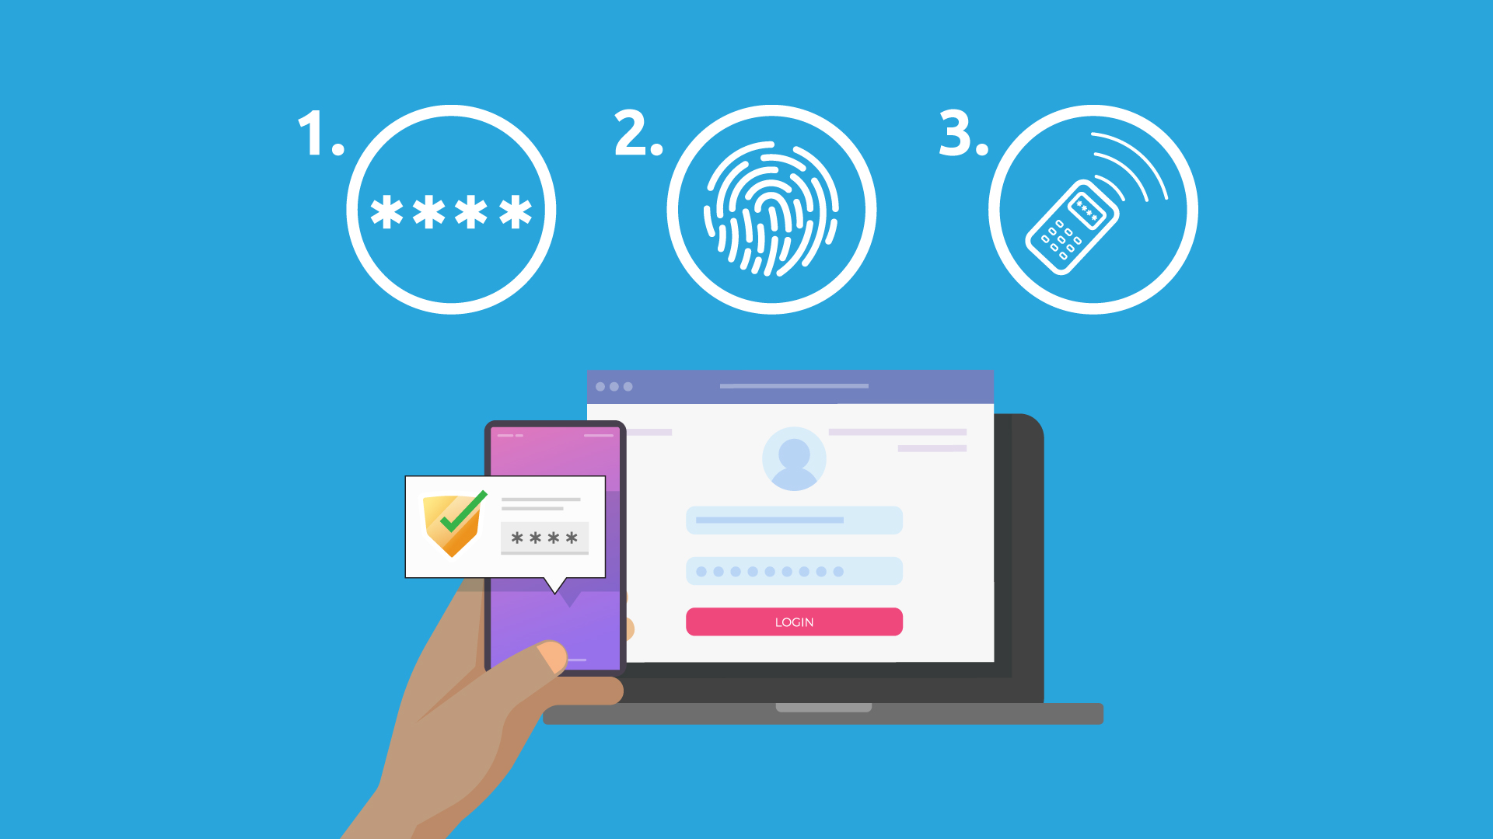

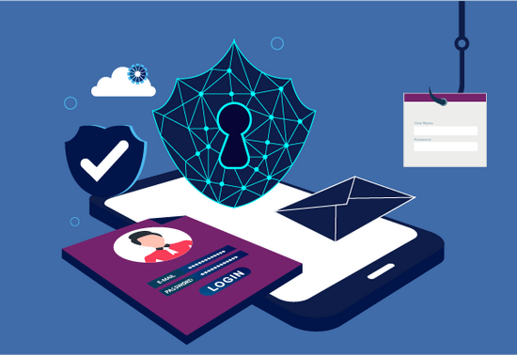
Think before you click → always verify links and attachments.
Check sender address → even one wrong letter can mean a fake.
Use Multi-Factor Authentication (MFA) → adds extra security.
Update software regularly → patches protect from malware.
Report phishing attempts to IT/security team immediately.

Slide 16
7
Real-World Phishing Cases

Slide 17
Attackers phoned Twitter employees, pretending to be IT support. They gained internal access and hijacked verified accounts (e.g., Elon Musk, Obama) to post bitcoin scams. Impact: Caused massive reputational damage.
Attackers used a stolen password obtained through phishing to access systems, leading to ransomware infection. Impact: Caused major fuel shortages in the U.S.
Dropbox Breach (2022)
Twitter Bitcoin Scam (2020)
Colonial Pipeline (2021)
Employees received fake CircleCI integration emails. The phishing site collected credentials and MFA codes. Impact: Source code and internal data were compromised.
A Lithuanian hacker impersonated a hardware supplier (Quanta Computer) and sent fake invoices to both companies. Impact: Over $100 million was stolen before being discovered.
Democratic National Committee (2016)
Staff received a fake Gmail security alert asking them to reset their password. The phishing link stole login credentials. Impact: Led to email leaks that affected U.S. elections.
Google & Facebook (2013–2015)

Slide 18
8
Interactive Quiz

Slide 19
Question 1: You get an email: “Your Netflix subscription will be cancelled! Click here to update your payment info”. What should you do?
A. Click the link and enter details
B. Delete and report to IT/security
C. Forward to a friend for advice
Question 2: Which tactic is used when attackers follow an authorised person into a restricted area?
A. Tailgating / Piggybacking
B. Pretexting
C. Official company logo
Question 4: Which of the following is a red flag in an email?
A. Generic greeting (“Dear Customer”)
B. Grammar mistakes and urgent tone
C. Official company logo
Question 3: You receive a call from “IT Support” asking for your password to fix your computer. What should you do?
A. Share the password immediately
B. Hang up and verify through official IT contact
C. Ignore it
Question 6: An email claims you won a free iPhone. It asks you to fill in personal details to claim it. This is an example of?
A. Phishing / Social Engineering
B. Legitimate promotion
C. Internal company survey
Question 5: Which domain is likely fake?
A. paypal.com
B. paypal-secure.com
C. paypa1.com

Slide 20
9
Conclusion

Slide 21
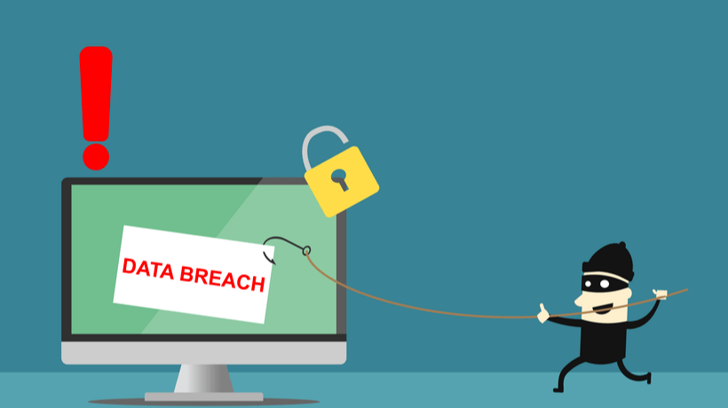
Phishing is one of the easiest yet most dangerous cyberattacks. Awareness and attention are your best defences.
Remember: Think before you click – verify before you trust.

Slide 22
THANKS FOR YOUR ATTENTION!

